Slide 1



5G Rollout Impact
WaveCon Insights
Presented by Karan Bharale

Slide 2


Agenda Overview
01
About Company
02
Overview of the Dashboard
03
Revenue Impact of 5G Launch
04
Underperforming KPI after 5G Launch
05
Top Performing Plans Post-5G Launch
06
Underperforming Plans Post-5G Launch
07
Plan Discontinuation After 5G Launch
08
Recommendations and Strategic Actions

Slide 3




About WaveCon
Overview
WaveCon is a leading telecommunications provider, known for delivering high-speed internet, mobile, and digital services across Indian Market.
With a large and growing customer base, WaveCon leads the way in technological advancements, providing innovative solutions tailored to individual consumers and enterprise clients.
Mission
To provide reliable, cutting-edge connectivity solutions, empowering customers with the speed and quality they need in the digital age.
5G Leadership
WaveCon is one of the early adopters of 5G technology, striving to redefine mobile and internet experiences by delivering faster speeds, reduced latency, and more robust network performance.
Customer Commitment
Dedicated to enhancing customer experience through continuous network improvements, innovative plans, and responsive customer service.

Slide 4
Dashboard Link
https://app.powerbi.com/view?r=eyJrIjoiYmZhY2NkZDktMjM0Ni00MWE1LWE3OTMtMWUxMmFkOTgwZDE4IiwidCI6ImM2ZTU0OWIzLTVmNDUtNDAzMi1hYWU5LWQ0MjQ0ZGM1YjJjNCJ9

Slide 5


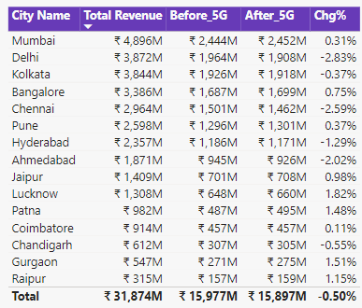
Revenue Impact of 5G Launch
What is the impact of the 5G launch on our revenue?
Total Revenue 31.9Bn
INSIGHTS:
Total revenue decreased from 15,977M to 15,897M, reflecting a 0.50% drop after the 5G launch.
The introduction of 5G negatively impacted overall revenue by -0.50%.
Delhi experienced the highest revenue decline, with a 2.83% decrease, marking it as the most affected city post-5G launch.

Slide 6


Underperforming KPI after 5G Launch
2. Which KPI is underperforming after the 5G launch?
Total Active Users
161.7M
Total Unsubscribed Users
161.7M
INSIGHTS:
The underperforming KPI post-5G launch is Total Active Users (TAU), which saw a decline from 88.4 million to 77.4 million.
TAU dropped by 8.28%, marking a significant negative shift in user engagement.
Total Unsubscribed Users increased by 23.50% after the 5G rollout.

Slide 7
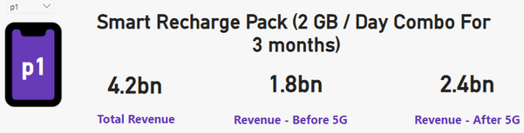
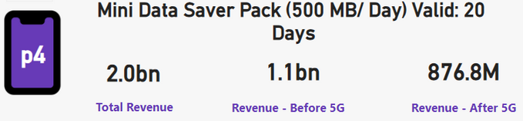
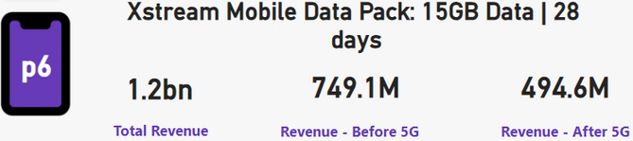
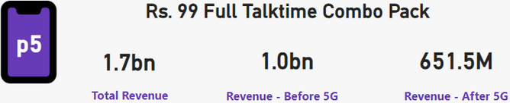
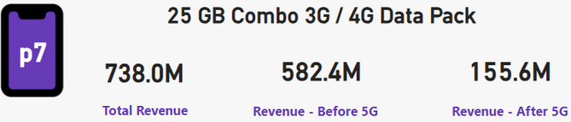
Top Performing Plans Post-5G Launch
3. After the 5G launch, which plans are performing well in terms of revenue? Which plans are not performing well?
Performing Well
NotPerforming Well
INSIGHTS:
Plan P1 showed strong performance, with a 33.33% increase in revenue compared to pre-5G levels, making it one of the best-performing plans after the 5G launch.
In contrast, plans P4, P5, P6, and P7 experienced revenue declines of 20.29%, 34.85%, 33.97%, and 73.28% respectively, indicating a significant drop in their performance post-5G.

Slide 8

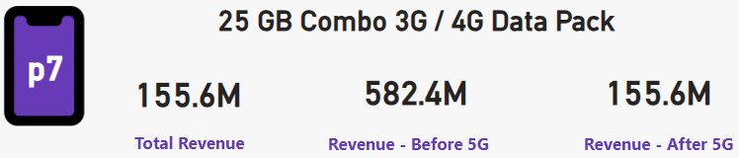
Underperforming Plans Post-5G Launch
4. Is there any plan affected largely by the 5G launch? Should we continue or discontinue that plan?
73.28%
INSIGHTS:
Plan P7 experienced a significant revenue drop of 73.28% compared to pre-5G levels, making it the most affected plan after the launch.
This indicates that users are rapidly shifting to 5G, leaving Plan P7 behind.
The revenue for Plan P7 dropped from 582.4 million to 155.6 million, a 73.28% reduction.
Given the sharp decline, WaveCon should consider discontinuing Plan P7 to optimize profitability and focus on more competitive offerings.

Slide 9
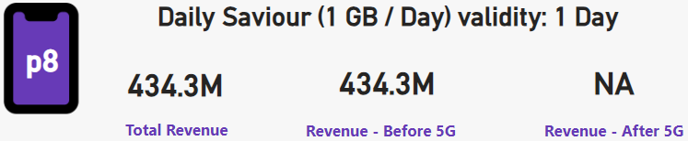
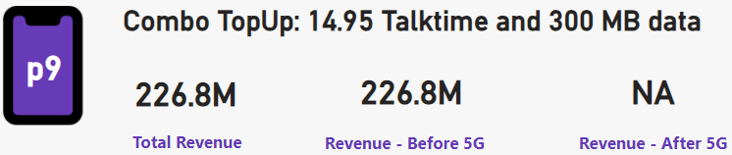
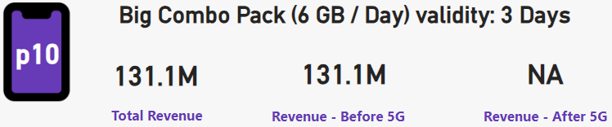
Plan Discontinuation After 5G Launch
5. Is there any plan that is discontinued after the 5G launch? What is the reason for it?
INSIGHTS:
Plans 8, 9, and 10 were discontinued due to low data limits, which were insufficient for 5G users.
These plans were among the least popular and generated the lowest revenue.
Discontinuing these plans was a strategic decision to minimize losses.
Reviving them would require increasing data limits to meet 5G demands.

Slide 10
Recommendations and Strategic Actions
Promote High-Performing Plans: Focus marketing efforts on plans like P1, which have shown strong revenue growth post-5G launch.
Discontinue Underperforming Plans: Consider discontinuing Plan P7 and other low-revenue plans to optimize profitability.
Revise Data Limits: Upgrade data limits for discontinued and underperforming plans to better align with 5G user needs.
Improve Customer Retention: Address the increase in unsubscribed users by enhancing customer support and offering more competitive data plans.
Leverage Growth Cities: Capitalize on cities like Pune, Lucknow, and Chennai, where active user growth remains positive after the 5G launch.

Slide 11


Thanks For Watching !!
Karan
Bharale
Follow for more on LinkedIn

